Slide 1

Fictional Cyclistic Company
Cyclistic Rider Behavior Analysis & Membership Conversion Strategy
Data‑Driven Insights for Increasing Annual Memberships
AUGUST 2026
Notes:
Good afternoon, everyone.
Today, I’m presenting insights from our analysis of Cyclistic’s historical bike‑share data.
Our goal is to understand how casual riders and annual members use Cyclistic differently.
These insights will directly inform our strategy to convert casual riders into annual members — the segment that drives long‑term profitability.

Slide 2

The Company
●Cyclistic is a public bike‑share service operating across Chicago, offering thousands of bicycles distributed through a network of docking stations throughout the city.
The problem
●Riders can unlock a bike at one station and return it to any other, making Cyclistic a flexible mobility option for commuters, tourists, and recreational riders.
Notes:
Cyclistic’s business model includes:
Single‑ride passes
Full‑day passes
Annual memberships
While casual riders (single‑ride and day‑pass users) make up a large portion of total trips, annual members generate more stable, predictable revenue and demonstrate higher long‑term engagement.

Slide 3

The Context
●Cyclistic’s leadership has identified a strategic challenge:
although casual riders frequently use the service, they don't contribute to long‑term revenue growth the same way annual members do.
The problem
●The marketing director believes that converting casual riders into annual members is essential for Cyclistic’s future success.
Notes:
To move forward, executives require clear, compelling evidence—supported by professional data visualizations—that demonstrates:
How the two rider groups behave differently
Where opportunities for conversion exist
Why targeted membership campaigns will be effective

Slide 4
Problem Statement
●Without data‑backed insights, Cyclistic cannot design effective marketing strategies to convert casual riders into annual members.
The problem
●A comprehensive analysis of historical trip data—supported by—is required to identify behavioral differences, uncover conversion opportunities, and justify strategic recommendations to Cyclistic executives.

Slide 5

Project Goals
Goal 1 — Understand behavioral differences between rider types
Identify how casual riders and annual members differ in:
Ride frequency
Ride duration
Day‑of‑week usage
Time‑of‑day patterns
Station usage
Notes:
These insights will reveal the motivations, habits, and needs of each group.

Slide 6
Project Goals
Goal 2 — Identify conversion opportunities
Use behavioral patterns to pinpoint:
When casual riders are most active
Where they ride
What value propositions would appeal to them
Notes:
This allows Cyclistic to design behavior‑aligned membership offers.

Slide 7
Project Goals
Goal 3 — Recommend a targeted membership strategy
Translate insights into actionable marketing tactics that:
Increase membership adoption
Improve customer lifetime value
Strengthen Cyclistic’s competitive position

Slide 8

Why Membership Growth Matters
Annual members = higher lifetime value
Casual riders = warm leads already using Cyclistic
Goal: convert casual riders into members
Notes:
Annual members generate significantly more predictable revenue.
Casual riders already know and trust Cyclistic — they’re the warmest leads we have.
If we understand their behavior, we can design targeted campaigns that speak directly to their needs and habits.

Slide 9

How I Achieve These Goals
Using fields such as ride_id, rideable_type, started_at, ended_at, station names/IDs, GPS coordinates, and member_casual, I:
Calculate ride length
Extract day of week and hour of day
Standardize rider type
Validate timestamps and station data
This ensures accurate analysis.
Dataset Overview
Notes:
Steps — Clean and prepare the dataset
Build Tableau calculated fields
Key fields include:
Ride Length (Minutes)
Day of Week
Hour of Day
Rider Type (cleaned)
These power all visualizations.
Each visualization is designed to answer a specific business question:
Ride Frequency: Who rides more often?
Ride Duration: Who takes longer trips?
Day‑of‑Week Patterns: When do casual riders vs members ride?
Ride Length Trends: How does duration change across the week?
Station Hotspots: Where do casual riders cluster?
Bike Type Preference: Which bikes do casual riders prefer?
Time‑of‑Day Patterns: Are they commuters or leisure riders?
These visuals make the behavioral differences unmistakable.

Slide 10

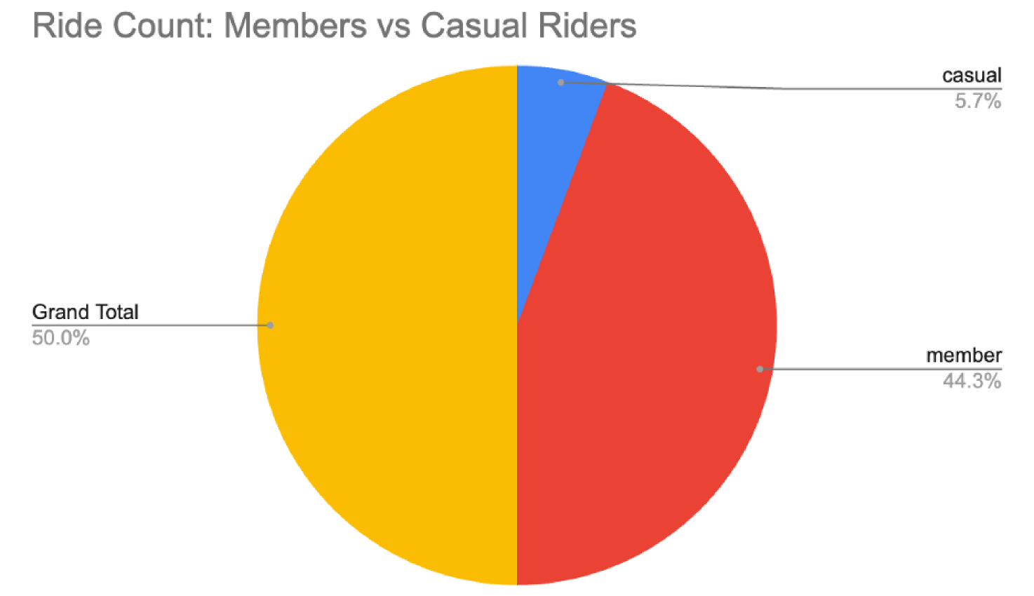
Insight 1: Members Ride More Frequently
Notes:
Members ride far more often than casual riders.
Indicates commuter‑driven, habitual usage.
Casual riders use Cyclistic occasionally — a key conversion opportunity.

Slide 11

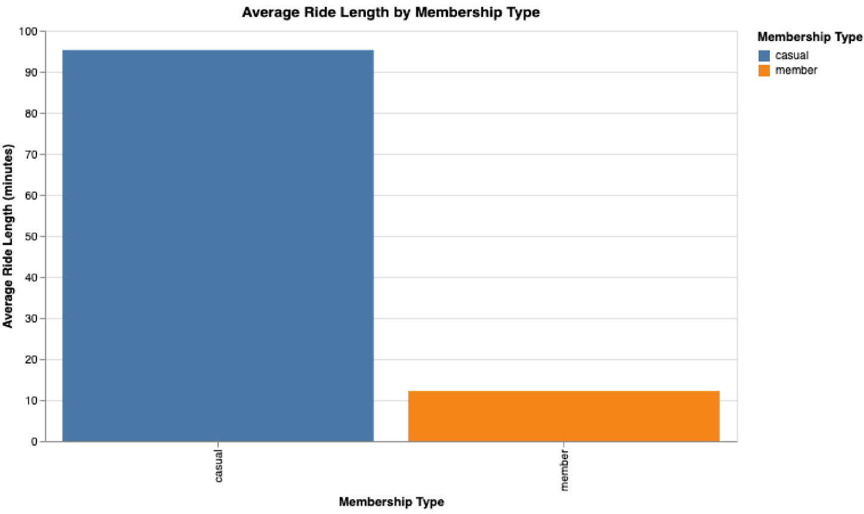
Insight 2: Casual Riders Take Longer Trips
Notes:
Casual riders consistently take longer rides.
Suggests leisure, tourism, weekend exploration.
Membership can be framed as cost savings for long rides.

Slide 12

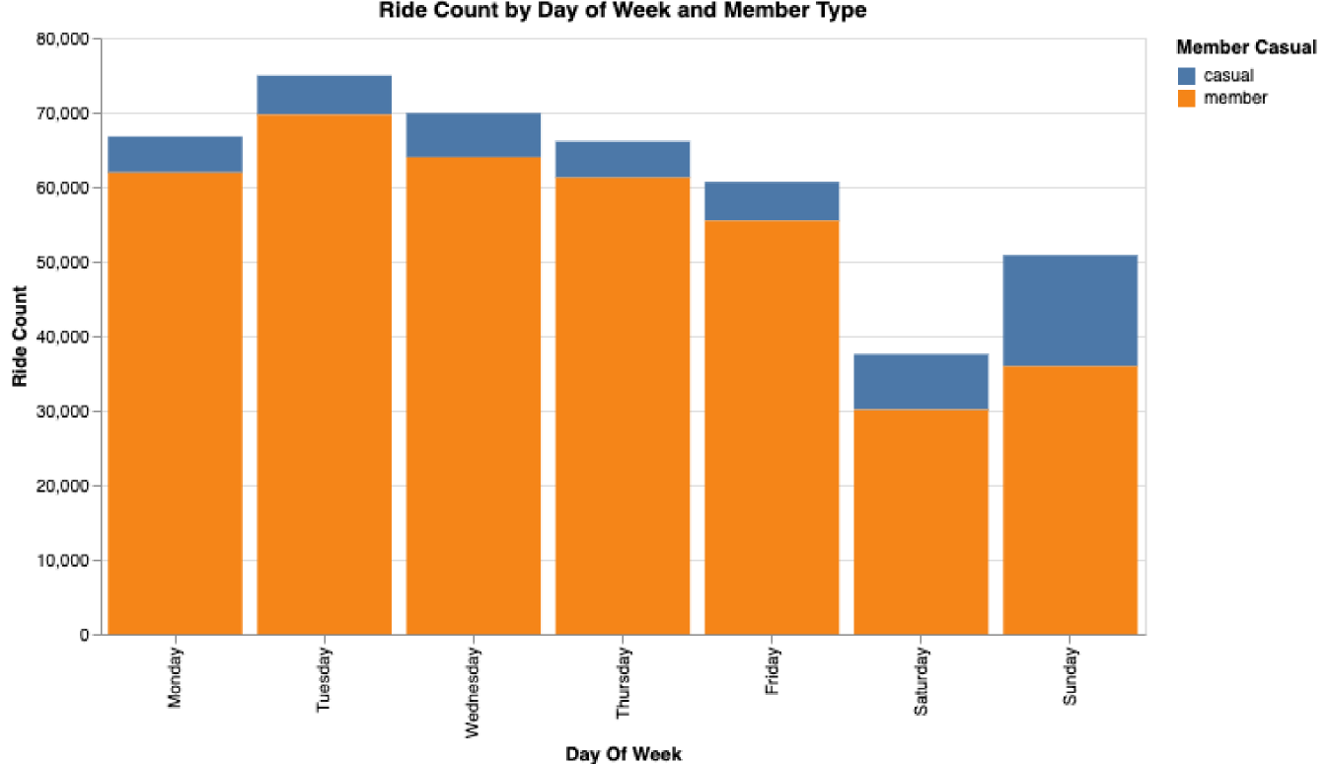
Insight 3: Day‑of‑Week Patterns
Notes:
· Members account for 88.64% of total Ride Count, significantly outperforming casual riders at 11.36%.
· Ride Count increased by 35.3% from period 6 to 7.
· However, overall Ride Count decreased by 23.85% from Monday to Sunday, with a significant 49.86% drop from Tuesday to Saturday.
· The maximum Ride Count (69,697) was recorded for members on Tuesday, while the minimum (4855) was for casual riders on Monday.
Members peak Monday–Friday.
Casual riders peak Saturday–Sunday.
Confirms two distinct personas: commuters vs leisure riders.

Slide 13

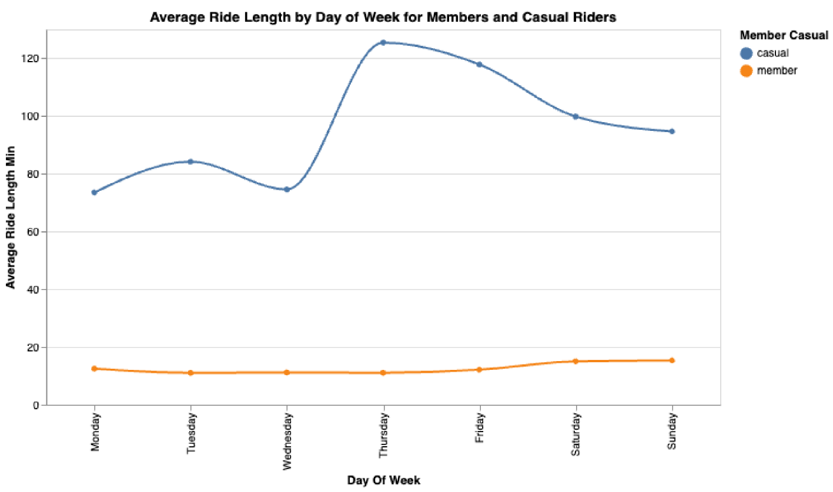
Insight 4: Ride Length Trends Across Days
Notes:
· Casual users' average ride length increased by 28.81% from Monday to Sunday, peaking at 125.43 minutes on Thursday.
· Member users also experienced a 22.77% increase in average ride length from Monday to Sunday, with their minimum of 11.04 minutes on Tuesday.
· Notably, casual users consistently exhibit significantly longer average ride lengths, with their maximum being over ten times the member minimum.

Slide 14

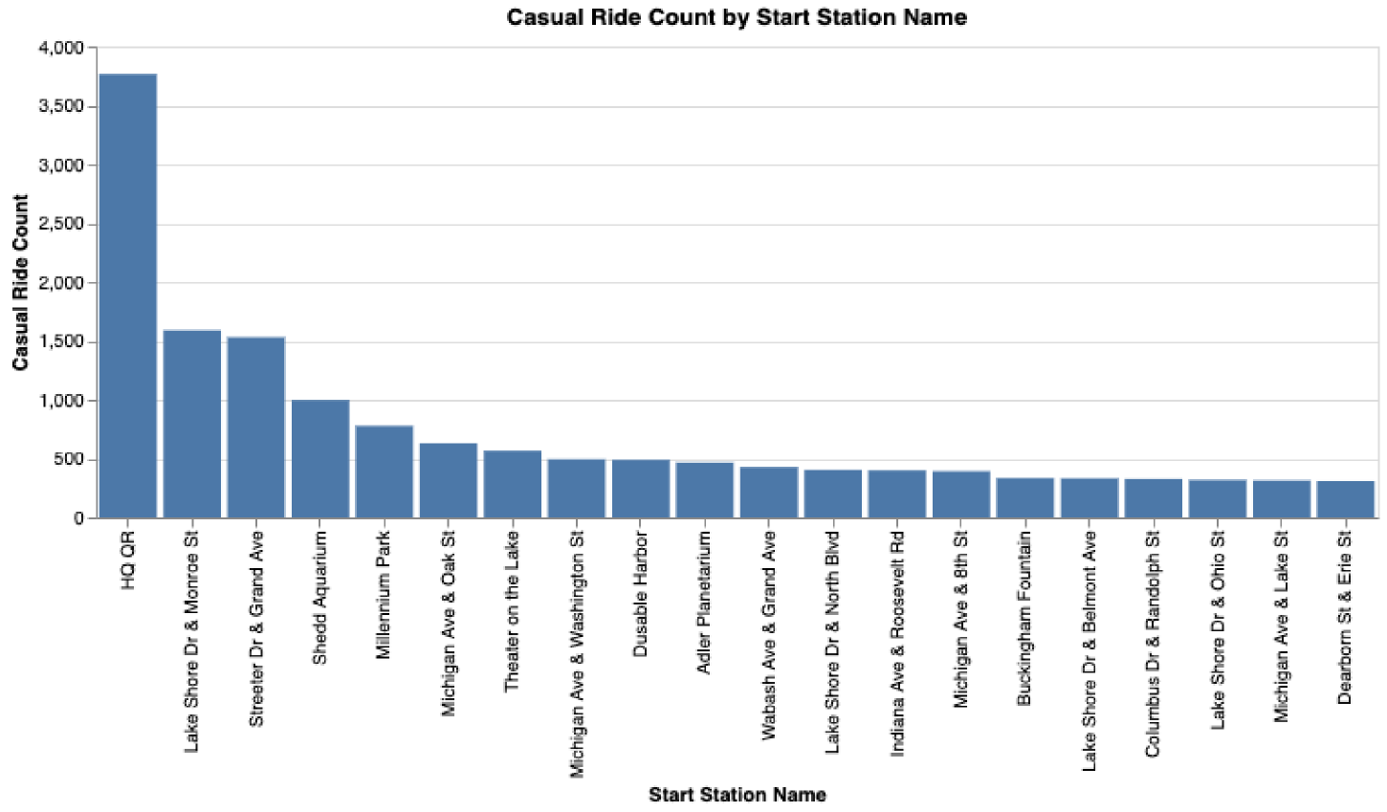
Insight 5: High‑Traffic Stations
Notes:
· HQ QR has the highest Casual Ride Count at 3766, comprising 25.34% of the total and significantly exceeding the average of 743.05. Dearborn St & Erie St recorded the lowest count at 308, representing 2.07% of the total.
These stations are ideal for targeted membership promotions such as:
QR‑code membership offers
Kiosk messaging
Geo‑targeted digital ads

Slide 15

Strategic Recommendations
Based on these insights, the following strategies are most likely to convert casual riders into annual members:
1. Weekend‑Focused Membership Perks
2. Unlimited Ride Plans for Leisure Users
3. Geo‑Targeted Ads at High‑Traffic Stations
4. Digital Campaigns Tailored to Casual Rider Behavior
Notes:
Highlight unlimited weekend rides, discounted leisure plans, or “weekend adventure memberships.”
Position membership as a cost‑saving alternative for long, frequent weekend rides.
Deploy targeted messaging at HQ QR.
Use app notifications, social media ads, and email campaigns timed around weekend peaks.
These strategies align membership benefits with casual riders’ existing habits, increasing the likelihood of conversion.

Slide 16
Executive Summary
Cyclistic’s historical trip data reveals clear behavioral differences between casual riders and annual members.
Members ride more frequently and consistently, especially during commute hours, indicating commuter‑driven usage.
Casual riders take longer trips, ride mostly on weekends, and cluster around Chicago’s major leisure destinations.
Notes:
These insights provide actionable pathways to increase annual memberships through targeted, behavior-aligned marketing strategies. By focusing on weekend engagement, leisure behavior, electric bike preferences, and high‑traffic stations, Cyclistic can convert casual riders into long‑term members and strengthen its revenue base.

